Slide 1
Natural Skin Care Trusted For Generations

Slide 2
A History of Great Natural Skin Care
Reviva Labs was established by Steven Strassler in 1973. As one of the first licensed aestheticians in the United States, Mr. Strassler combined his training with his interest in natural ingredients to create a new approach to skincare – a line of individual products for individual skin care needs.
For the next 45 years, Reviva Labs has continued to be at the forefront of the natural skin care industry - formulating natural solutions to individual skin care need and pioneering innovations and “firsts” such as a non-chemical exfoliation (Light Skin Peel), the use of topical trace minerals as a catalyst for absorption, promoting the use of Elastin in the US, combining Hyaluronic Acid and Glycogen for a new ‘Intercellular’ approach in skin care and much more.
And, we’re not slowing down anytime soon!

Slide 3
Making Natural Skin Care Even Easier
What sets us apart:
Solution based skincare
Reviva products are organized into easy to identify ‘categories of concern’ with compatible skin types clearly indicated on the packages
Concept of layering
Reviva products are designed to work synergistically to enhance and effectively address multiple concerns and skincare needs.
Decades of experience launching innovative ingredients
Reviva Labs has a history of being first to market with new and effective skincare ingredients that work. Each formula undergoes extensive review and testing before being introduced: skin sensitivity, stability, effectiveness, and potency are all examined over the course of months (or years) during development.

Slide 4
Anti-Aging
Brightening
Defense
Firming
Our Anti-Aging collection focuses on keeping skin supple, wrinkle-free, and healthy. Peptides, antioxidants, firming ingredients, and moisturizers work together to nourish and rejuvenate your skin – delivering a naturally youthful complexion.
Reviva is well-known for the effectiveness of our Brightening collection. With ingredients proven to inhibit melanin production, our brightening products help reduce discoloration and even skin tone, leaving skin looking healthier and more radiant.
One of the most important parts of any skin care regimen is protection - from the sun as well as from other environmental factors. Reviva's Defense collection works to protect skin from the elements that can cause damage.
Skin that is tight and firm looks healthier and more youthful. With DMAE, antioxidants, Collagen, and Elastin, Reviva's Firming line helps lift sagging skin for a toned, firm look.
Hydrating
Restoring
Revitalizing
Specialty
Hydration is such an important part of any skin care routine, and Reviva's Hydrating collection contains ingredients such as Hyaluronic Acid, Collagen, and plant extracts to impart and maintain moisture in the skin.
As your body's largest organ, your skin is exposed daily to pollution, sun damage, and various toxins which can build up. Restoring your skin means removing dirt and toxins and replenishing vital moisture and nutrients.
Does your skin look or feel tired? Reviva's Revitalizing collection helps "wake up" your skin, energizing it with plant extracts and trace minerals to help skin look more radiant.
Reviva knows that no single product can be all things to all people - after all, everyone's skin is different. But that doesn't stop us from formulating products to address many different skin concerns. Our Specialty products address numerous skin care issues.

Slide 5
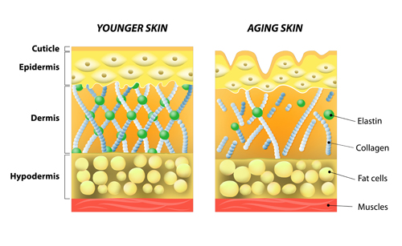
Skin 101 Review
The skin is the largest organ of the body:
Its major function is to:
Protect the body from environmental assaults
Prevent excessive water loss from the body
Protect the body from infection
What causes pre-mature aging:
Environment: Sun, pollution, extreme climates
Stress
Lifestyle habits: poor diet, smoking, excess alcohol
These assaults produce free radicals which damage the DNA in cells. Support systems break down - collagen, elastin and cell renewal slows down
Common skin concerns:
Lack of hydration, rough spots, fine lines
Lack of firmness, sagging, wrinkles
Uneven skin tone, dullness, brown spots

Slide 6
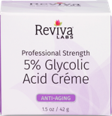
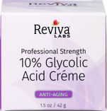
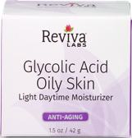
Anti-Aging Collection Target Consumer/Product Benefits
Glycolic Acid Facial Cleanser – MSRP $18
Deep-acting cleansing for aging or sun damaged skin
Provides mild exfoliation while it cleanses
Glycolic Acid Facial Toner – MSRP $18
Provides extra cleansing and pH balance
Enriched w/soothing emollients
5% Glycolic Acid Crème – MSRP $27.50
Provides mild, non-drying exfoliation in moisturizing base
Helps smooth lines/wrinkles & brighten discoloration or spots
10% Glycolic Acid Crème – MSRP $31.90
For skin that has become conditioned to 5% Glycolic Acid Crème
Great for aging, sun-damage or blemished skin
Higher potency – faster exfoliation
Re-texturizes skin
Glycolic Acid Oily Skin Light Daytime Moisturizer – MSRP $20.90
Regular use helps fight oily or blemished skin
Light formula uses botanical oils to avoid dehydrating skin
Softer, clearer and brighter complexion
Target Consumer
People concerned about visible changes in their skin due to environmental damage or aging.
Sun damage
Discoloration
Fine lines
Lack of firmness
Notes:
What Else You Should Know
Why is Cell Turnover important –To help maintain its strong barrier of protection, skin needs to renew or replace dead surface cells frequently. Normal cell renewal, called mitosis, happens approx. every 28 days. As we age, this cell turnover takes longer which can result in uneven skin tone and texture and/or dry spots.
Glycolic Acid – is an alpha hydroxyl acid derived from sugar. An alpha hydroxyl acid (AHA) works by loosening the bond or the ‘glue’ between skin cells (called keratinocytes) to speed up the renewal process for fresher, brighter, smoother skin.

Slide 7
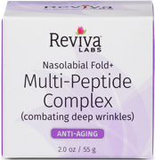
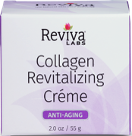
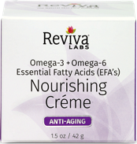
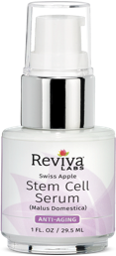
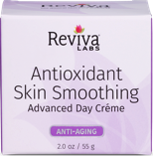
Anti-Aging Collection Target Consumer/Product Benefits
Nasolabial Fold Multi-Peptide Complex – MSRP $53.90
High-potency, multi-peptide formula helps combat appearance
of deep wrinkles on face & neck*
Helps reduce appearance of deep facial lines, including those at the
sides of the nose to the corners of mouth (nasolabial folds)
Collagen Revitalizing Crème – MSRP $38.50
Helps smoothes the appearance of wrinkles
Features special marine/botanical extracts, coconut & rich oils
Helps skin look & feel more youthful
Nourishing Crème Omega-3 + Omega-6 EFAs– MSRP $27.50
Helps skin feel supple & look radiant, smoother
Unique complex of 10 oils rich in Omega-3 & Omega-6 fatty acids
Swiss Apple Stem Cell Serum – MSRP $33
Select organic botanicals provide texturizing and anti-aging benefits
Swiss apple stem cells help revive skin’s own dormant stem cells and
Help bring new life & energy to epidermis. Recharging epidermal cells
makes skin more responsive to day & night creams applied over serum
Antioxidant Skin Smoothing Advanced Day Crème – MSRP $25.30
Defends against future damage with Antioxidant Complex
Natural Oils help combat past damage and contribute to healthy glow*
Helps diminish appearance of fine lines/wrinkles
Key Ingredients
Glycolic Acid - derived from sugar cane, and an active AHA, it has the ability to deeply penetrate skin to effectively help diminish visible signs of aging. Smoothes fine lines, wrinkles and brightens discoloration or spots. May also help reduce for acne breakouts
Alpha Lipoic Acid – very potent antioxidant, increases cellular energy & fights free radical damage. Helps diminish redness, brightens dull skin tone, smoothes fine lines & wrinkles. Boosts activity of other antioxidants.
Vitamin C & E – help protect and prevent damage from UV light, helps smooth and firm skin & improves discoloration.
Green & Black Tea - contain polyphenols which have shown to have antioxidant & antibacterial proper-ties, helps acne prone skin
Emollients – Hyaluronic Acid, Borage Oil, Rosehip Fruit Oil & Lavender Essential Oil, Flaxseed Oil to rehydrate, smooth and soften fine lines & wrinkles
Notes:
What Else You Should Know
*Nasolabial Fold Multi-Peptide Complex Peptide Include: Matrixyl™ (Palmitoyl Pentapeptide-4) – stimulates collagen production Progeline™ (Trifluoroacetyl Tripeptide-2) – helps improve collagen synthesis and firm up or tighten the appearance of skin. Syn-ake™ (Dipeptide Diaminobutytoyl Benzylamide Diacetate) – helps reduce appearance of wrinkles & nasolabial fold.
*Nourishing Crème – EFAs (Essential Fatty Acids) are major factor in fullness, bounce & thickness in youthful skin. Loss of EFAs affect cell membrane structure, resulting in dry, hard, thin and more easily bruised skin. Natural Oils: sunflower, flaxseed, borage, rosehip, hemp, avocado, wheat germ, black current seed, olive and sesame seed

Slide 8
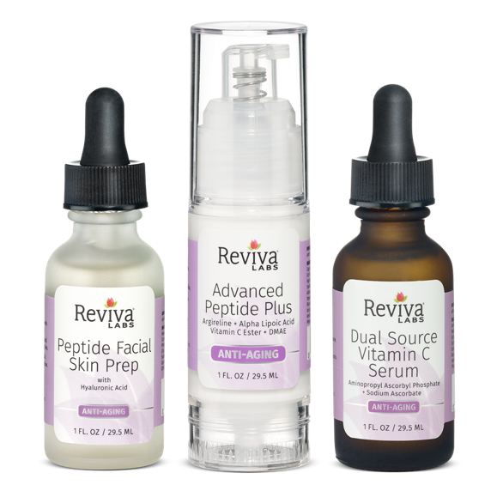
Anti-Aging Anti-Aging Trio
Reviva Labs Anti-Aging Trio
The first of our new targeted multi-product protocols
1. Peptide Facial Skin Prep
2. Advanced Peptide Plus
3. Dual Source C Serum
A Multi-Product Layering Protocol
While Reviva’s skin care offers many ‘stand alone’ anti-aging items, our new Anti-Aging Trio takes a layered approach to fighting off the effects of environmental damage.
Effective on their own, but more powerful together, this three-step protocol will has skin looking and feeling younger and healthier in no time.

Slide 9
Anti-Aging
Peptide Facial Skin Prep with Hyaluronic Acid
Benefits
A lightweight gel serum that energizes as it restores.
Moisturizes, restores & energizes w/Hyaluronic Acid & Argireline, a peptide, thought to have a similar action to Botox. It works to relax the muscles the near the top of skin, helping to diminish the look of fine lines and wrinkles
Restores & rebalances minerals essential to healthy skin - Hawaiian Seaweed Extract Mineral Complex: Magnesium, Calcium, Potassium, Phosphorous, Sodium, Iron, Manganese, Zinc, Copper
Energizes skin cells and helps absorption of all follow up items
What are peptides?
Naturally occurring amino acids and building blocks of proteins like collagen. As skin ages, the natural supply of collagen decreases contributing to fine lines & wrinkle development. Applying topical peptides in conjunction with moisture binding Hyaluronic Acid, has shown to help stimulate skin cell growth and repair.
314

Slide 10
Anti-Aging
Advanced Peptide Plus
Argireline + Alpha Lipoic Acid + Vitamin C Ester + DMAE
Benefits
A creamy serum that provides a smoother, more youthful glow with antioxidants, peptides and skin brightening
Quickly reduces the appearance of fine lines & wrinkles
Helps repair & prevent damaged skin
Aged skin immediately appears tightened & firmed
Proven Effect Ingredients
10% Argireline – a peptide, relaxes muscles near the top of skin, helps diminish the look of fine lines & wrinkles
Alpha Lipoic Acid – a powerful antioxidant, protects entire cell from free radical damage and helps reduce inflammation.
DMAE – Helps tighten skin, smooth fine lines, enhances effects of Vit C, E & Alpha Lipoic Acid
Vitamin C Ester – a fat-soluble form of Vit C, improves elasticity, may help reduce appearance of hyperpigmentation, brightens
While results are immediately visible, daily use will provide cumulative benefits, diminishing the appearance of fine lines and wrinkles and hyperpigmentation.
313
Notes:
What Else You Should Know
Ingredient questions we sometimes get:
Glycerin – is Palm Oil (plant based)
Collagen – is animal sourced
Squalene – is sourced from olives

Slide 11
Anti-Aging
Dual Source Vitamin C Serum
Aminopropyl Ascorbyl Phosphate + Sodium Ascorbate
Benefits
A potent, lightweight gel serum that helps to encourage the skin’s restorative abilities, corrects existing environmental damage while combating future damage.
Helps repair environmental skin damage.
Two forms of Vitamin C work together to promote collagen synthesis.
Reduces appearance of dark/age spots.
Why two forms of Vitamin C?
Aminopropyl Ascorbyl Phosphate (3-AAP) & Ascorbic Acid are potent yet gentle, water soluble derivatives of Vitamin C. According to research, Vitamin C has been shown to neutralize free radicals and stimulate DNA repair*.
Studies suggest that Vitamin C serums might correct age associated structural changes, or photodamage, that can accumulate over years. As skin ages, regularly applying Vitamin C is one of the most effective ways to boost collagen synthesis and slow its degradation to help maintain healthy, younger-looking skin.*
*truthinaging.com/review/get-to-know-your-vitamin-c, lpi.oregonstate.edu/mic/health-disease/skin-health
233

Slide 12
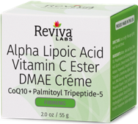
Firming Collection Target Consumer/Product Benefits
Elastin Collagen Skin Toner – MSRP $12
Alcohol free toner for face & neck
Stimulates, refreshes, refines and restores balance to skin with Vitamin A & E
DMAE Concentrate – MSRP $20.90
High levels of DMAE concentrate helps skin to appear more firm & tighter (DMAE 5% competition have between .5-1%)
Excellent for throat and facial area for a more supple, youthful look
Alpha Lipoic Acid Vitamin C Ester DMAE Crème – MSRP $28
Precisely blended with antioxidants and DMAE to firm, tone & protect skin with Alpha Lipoic Acid & Vitamin C Ester
Helps to firm and improve elasticity with DMAE
Visibly reduces the appearance of fine lines & wrinkles with Palmitoyl Tripeptide-5 and CoQ10
Target Consumer
People concerned with the visible signs of aging due to the passage of time or environmental damage.
Sagging skin
Lack of firmness and tone
Lines & wrinkles
Notes:
What Else You Should Know:
The key ingredients in Alpha Lipoic Acid Vit C DMAE Crème (ALA, Vit C Ester, DMAE) are encased in soy liposome for deeper, slower release. Benefits are instant and long term with everyday use.

Slide 13
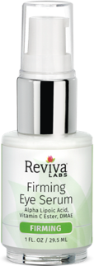
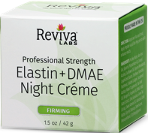
Firming Collection Product Benefits & Key Ingredients
Firming Eye Serum – MSRP $20.90
Helps reduce appearance of fine lines/wrinkles and reduce puffiness with DMAE, Alpha Lipoic Acid
Helps brighten look of dark circles with advanced peptides & Mulberry & Lime
Protects against future environmental damage with Alpha Lipoic Acid & Vitamin C Ester
Elastin & DMAE Night Crème – MSRP $18
Elastin & DMAE work together for extra firming benefits. Elastin provides firming & contouring while DMAE helps firm & tone.
Alternate every two weeks with Collagen Night Crème to replenish key firming needs
Elastin Collagen Body Firming Lotion – MSRP $22
Fights slackened skin during weight loss
Helps avoid stretch marks
Powdered Elastin Concentrate, the highest quality elastin available, plus premium soluble collagen
Key Ingredients
DMAE – Helps tighten skin, smooth fine lines, enhances effects of Vit C, E & Alpha Lipoic Acid. Fruit acid base. Helps increase Type 1 & 2 Collagen and dermal thickness. Result is reduced fine lines & wrinkles
Coenzyme Q10 – an antioxidant, may help improve the appearance of signs of aging, helps prevent & reduce effects of UV exposure & intrinsic aging
Alpha Lipoic Acid - a powerful antioxidant, protects entire cell from free radical damage and helps reduce inflammation
Vitamin C Ester– a fat-soluble form of Vit C, improves elasticity, may help reduce appearance of hyperpigmentation, brightens
Palmitoyl Tripeptide-5 – a potent peptide, encourages stimulation of collagen production

Slide 14
Reviva Labs Skin Care
Vitamin E-Stick
With SPF 15
Lip balm with Vitamin E and Allantoin in a natural beeswax base.
Moisturizes and soothes chapped, dry and cracked lips while protecting against UVA/UVB rays and wind damage.
Can apply over or under lipstick.
Translucent coverage ideal for women and men!
Our Vitamin E Oil E-Stick has been designed to naturally protect your lips which are vulnerable to drying and cracking or burning. But it can also be used under eyes, on cheeks, or any place that’s exposed to the sun or drying environments.
It’s natural beeswax base and soothing formula containing soy, Vitamin E and Allantoin will help to rehydrate dry, cracked lips while healing and soothing.
Directions: Apply to lips or under eyes for moisture and sun protection.
MSRP $5

Slide 15
Reviva Labs Skincare Collections Problem & Solutions
Problem | Solutions |  |  | Everyone Needs
Fine Lines & Wrinkles | Firming Collection | Anti-Aging Trio | Hyaluronic Acid Serum | Light Skin Peel Mild Exfoliant SPF 25 Sun Protective Moisturizer
Uneven, dull skin tone | Brightening Collection | Anti-Aging Trio |  | Light Skin Peel Mild Exfoliant SPF 25 Sun Protective Moisturizer
Dark Spots, discoloration | Brightening Collection | Anti-Aging Trio |  | Light Skin Peel Mild Exfoliant SPF 25 Sun Protective Moisturizer
Rough texture, flakiness, dehydrated, sensitive | Hydrating Collection | Anti-Aging Trio |  | Light Skin Peel Mild Exfoliant SPF 25 Sun Protective Moisturizer
Lack of firmness/tone, wrinkles | Firming Collection | Anti-Aging Trio | Collagen Serum & Collagen Night Crème | Light Skin Peel Mild Exfoliant SPF 25 Sun Protective Moisturizer

Slide 16
Natural Skin Care For All Skin Types

